Slide 1

Foundations of R for Bioinformatics
Dr Matthew Taylor
Institute of Cancer and Genomic Sciences
College of Medicine and Health
m.taylor.1@bham.ac.uk
Attendance code:

Slide 2
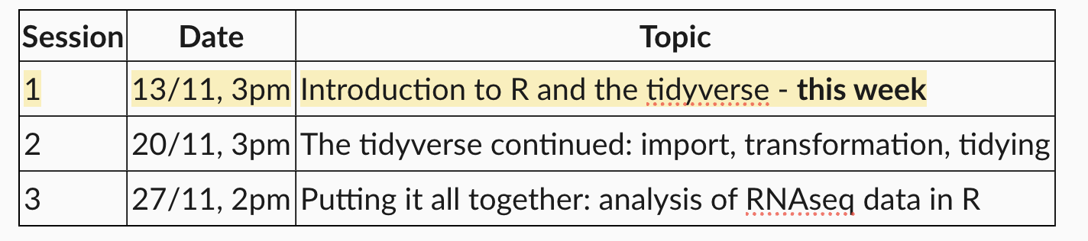
Course structure
Attendance code:

Slide 3
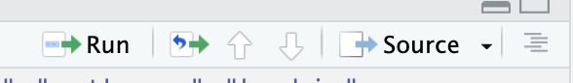
Initial setup—before first session
Go to https://posit.co/download/rstudio/
Follow the instructions for downloading and installing R and RStudio
Go to https://github.com/MattTaylor1209/MRes-R-course/
Click Code – Download Zip. Extract to a destination of your choice (E.g., Desktop).
Open that folder (Mres-R-course-main) and double click the file “Foundations of R for bioinformatics.Rproj”—it should open in RStudio.
In RStudio, click File – Open File – setup.R
Click the source button
Then File – Open File - navigate to the Session_1 folder and open Session_1.qmd
Attendance code:

Slide 4
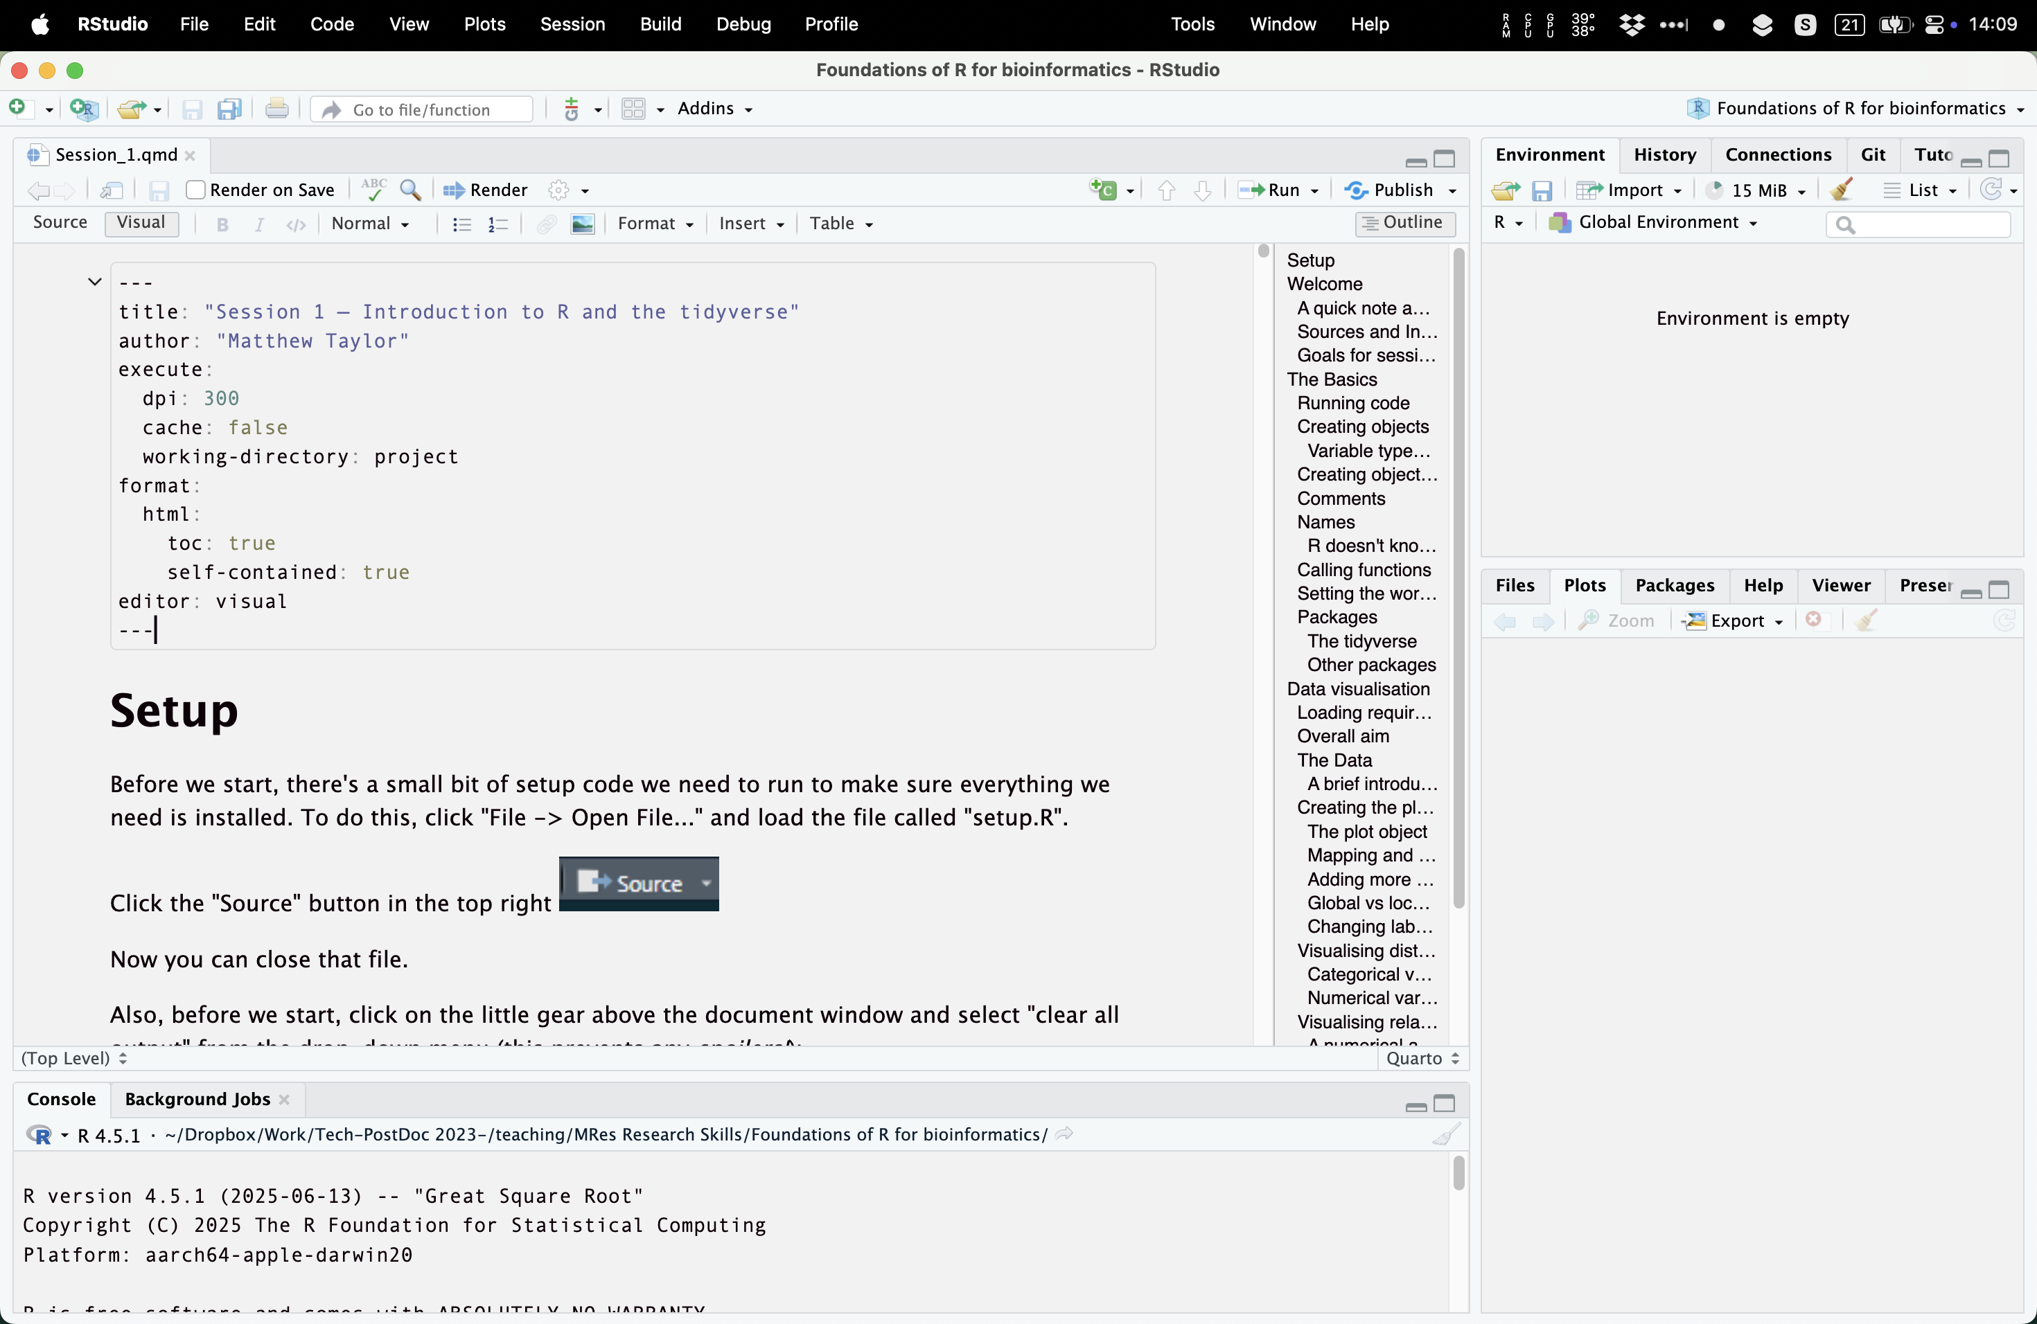
You should then see something like this

Slide 5



Welcome to R, RStudio and Quarto
R is a programming language for data analysis, statistics, visualisation…although you can really do any programming you want with it.
RStudio is an IDE (Integrated Development Environment) for R—basically a more user-friendly way of accessing the R language in a more familiar graphical user interface (GUI).
Quarto is a tool for creating reproducible documents that combine text, code, and output—letting you turn your R analyses into polished reports all in one place.

Slide 6
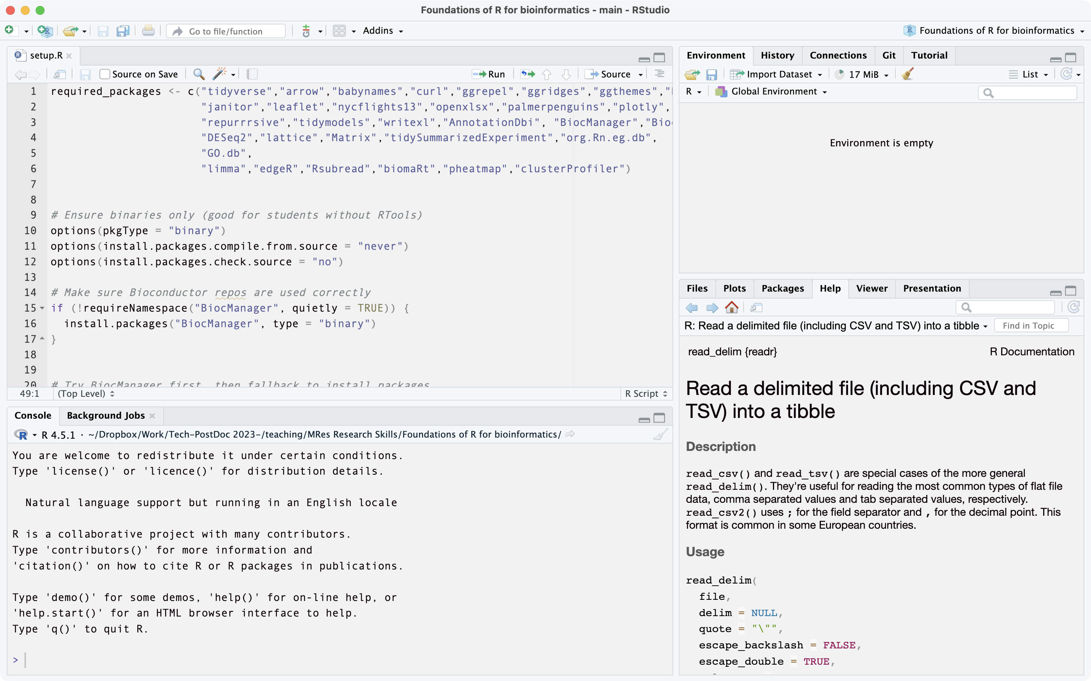
The RStudio interface
Environment / History Pane—Displays your objects, variables, and data frames currently in memory, and a history of commands you’ve run.
Tabs to select scripts/data frames currently loaded
Source (Script/Editor) Pane—Where you write, edit, and save your R scripts or Quarto documents.
Viewer pane—currently showing Help page but can also be used to preview plots and file tree
Console—where code is run and output appears. Can type code in here manually and press Enter to run; or run from a script in the window above.

Slide 7
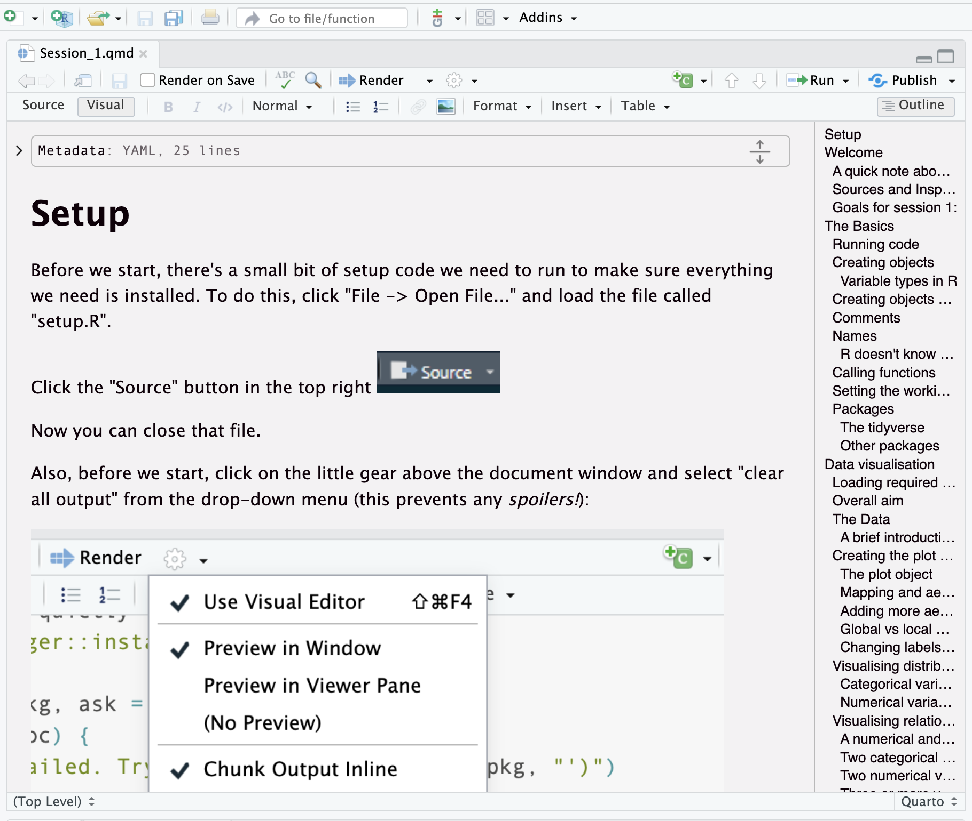
Quarto documents
Tool for inserting code chunk
YAML header—beyond the scope of this course but where you can set rendering and code execution options. Can be hidden or expanded with the little arrow.
To render into a document (e.g., HTML, PDF, word) to use e.g., as a report
Option to select between Source (markdown format) and Visual (more familiar) editor.
Outline to navigate to subsections quickly
Visual editor pane for writing text and inserting code
Example code chunk—can be run by clicking the green arrow.

Slide 8
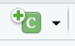
Format of this course
All sessions written using Quarto. These documents are yours to edit as you please. You can insert code to try things out by clicking
Feel free to work through the documents at your own pace; I will also be demonstrating the examples throughout the session.
At places in the documents, you will see bold text with a question, then either an empty code box or a box with some code missing (with the phrase YOUR_CODE_HERE). I recommend first thinking about the question, discussing it with your neighbour, and then trying to fill in the missing code. You can check it works by running the chunk using the little green arrow.
If you get stuck with a question, I am here to help. Also, I will have provided a model answer for each question which you will find by scrolling a little further down.

